Slide 1


Online second hand Book Sell and Buy
Group No.12

Slide 2
Presented By:-
1.Swapnil Khare
2.Mohit Singh
3.Vishal Kumar
4.Rishabh Kumar Tripathi
5.Nitin Singh
6.Bhupendra Kumar
Under The Supervision of:-
Mr.Anuj Kumar
(Asst.Professor)
Department of CEA
GLA University, Mathura

Slide 3
Content
Introduction
Problem Statement
Objective
Project Scope
Tools and Technology
ER Diagram
DFD
Layout
Conclusion
References

Slide 4
Introduction
Online Second hand Book store is an online web application where the customer can purchase and sell books online.
Through a web browser the customers can search for a book by its title or author, later can add to the shopping cart and finally purchase the books
User can Easily upload the cover photo of a book and finally sell the books

Slide 5
Problem Statement
Many people can’t afford to buy costly books, therefore by using this online platform they can buy the required books at a much cheaper price than available on other sources.
The users can sell and buy according to his/her need directly from the confines of their own homes without breaking a sweat searching in marketplace.

Slide 6
Objective
The main objective of “Online Second hand Book Store” is to provide an essence of online book store via a simple and yet powerful medium
Decrease the human efforts
Customer can easily find the categories of book

Slide 7
Project Scope
Time saving
Fast purchasing
View books of all categories
Available 24*7
In-expensive

Slide 8
Tools And Technology
HTML
CSS
JAVA SCRIPT
PHP
PAYMENT GATEWAY
Paypal
VISUAL STUDIO CODE

Slide 9
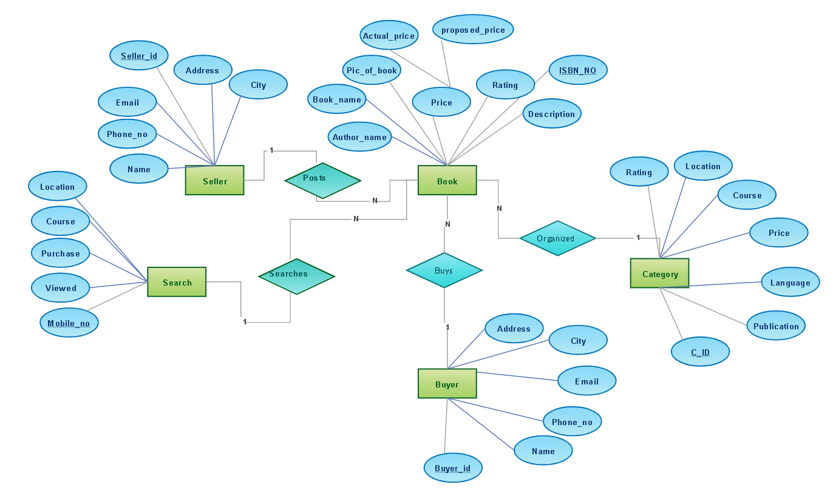
ER Diagram

Slide 10

DFD

Slide 11
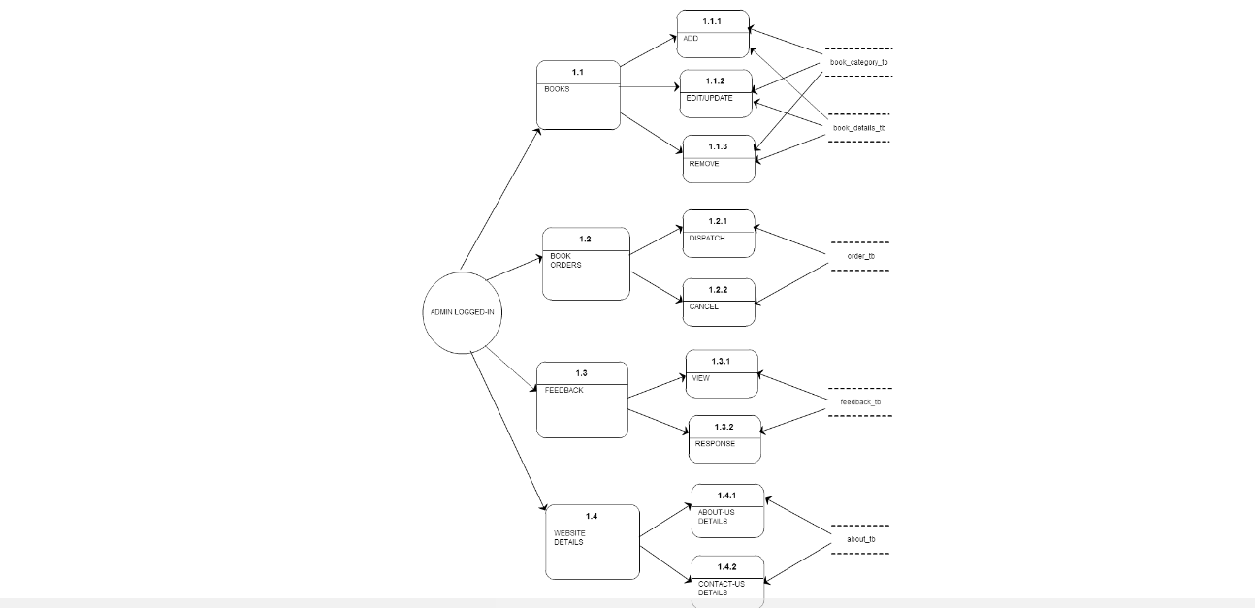
LEVEL 1 DFD

Slide 12
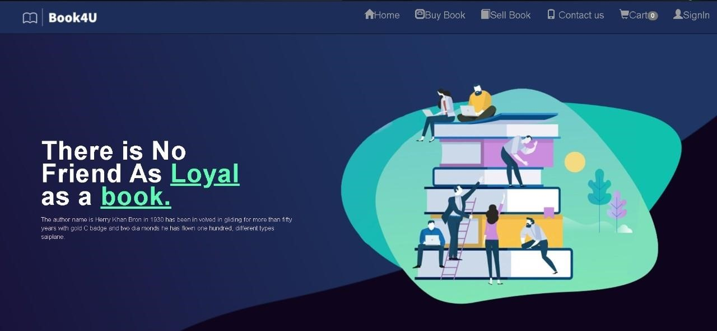
HOMEPAGE LAYOUT

Slide 13
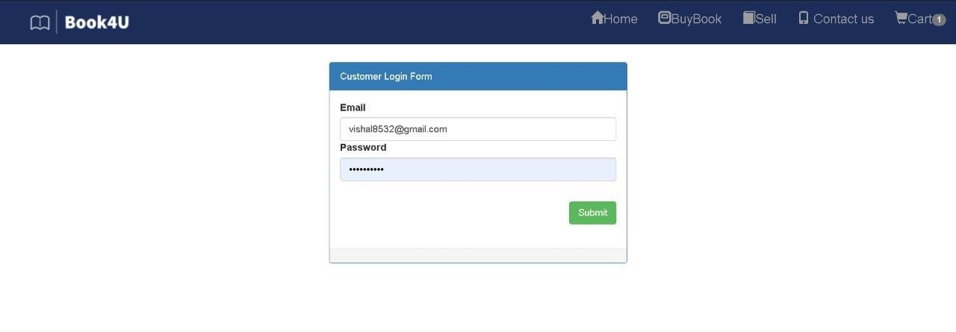
Customer login page

Slide 14
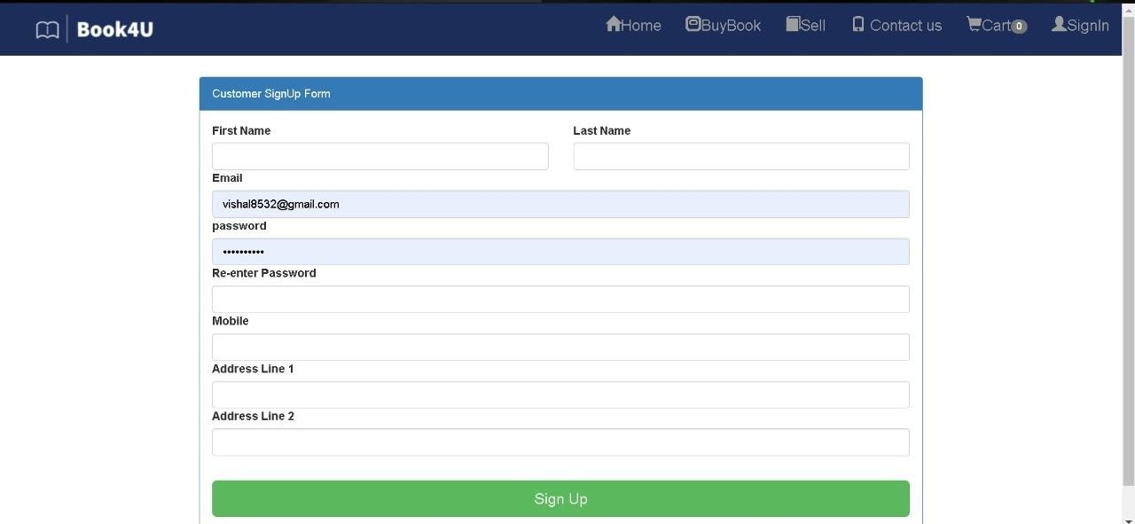
Customer signup page

Slide 15
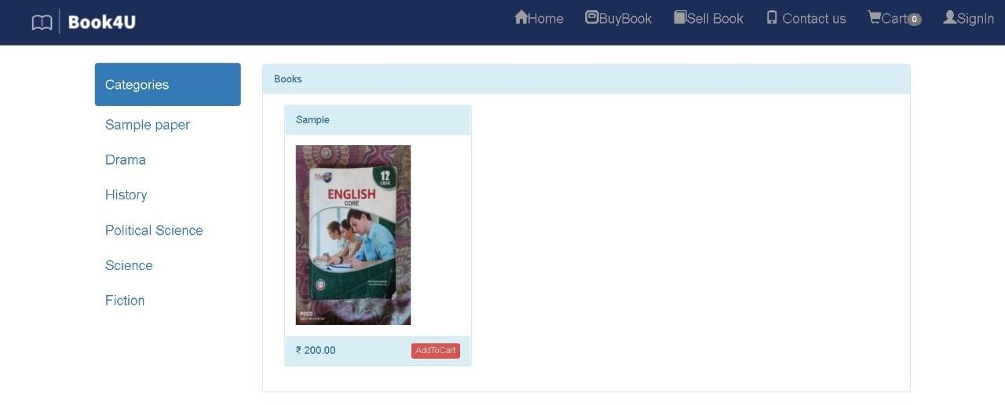
Buy page

Slide 16
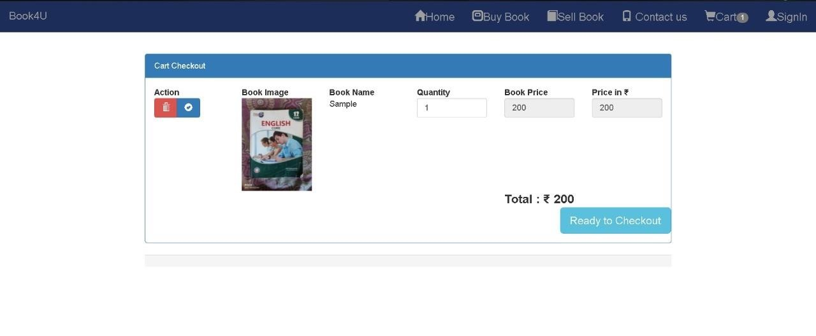
Cart

Slide 17
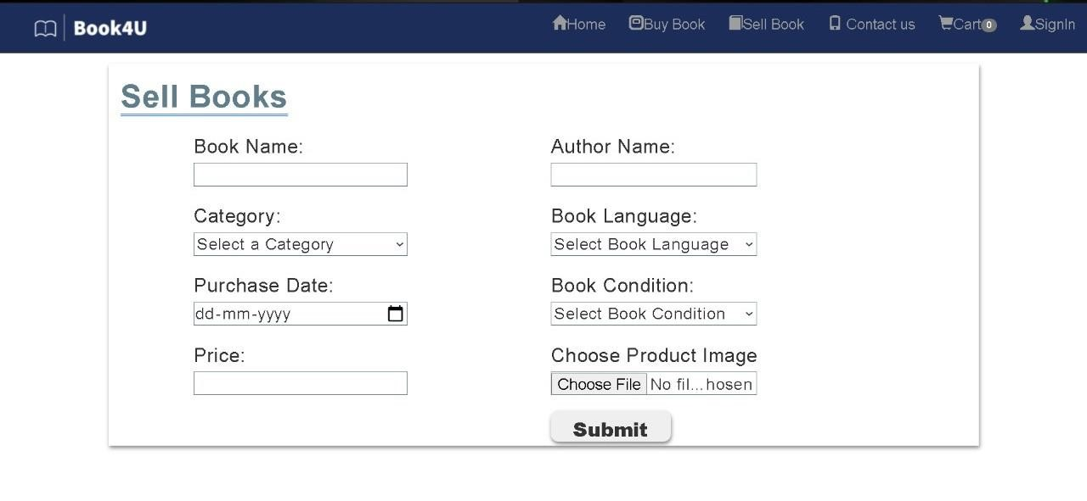
Sell page

Slide 18
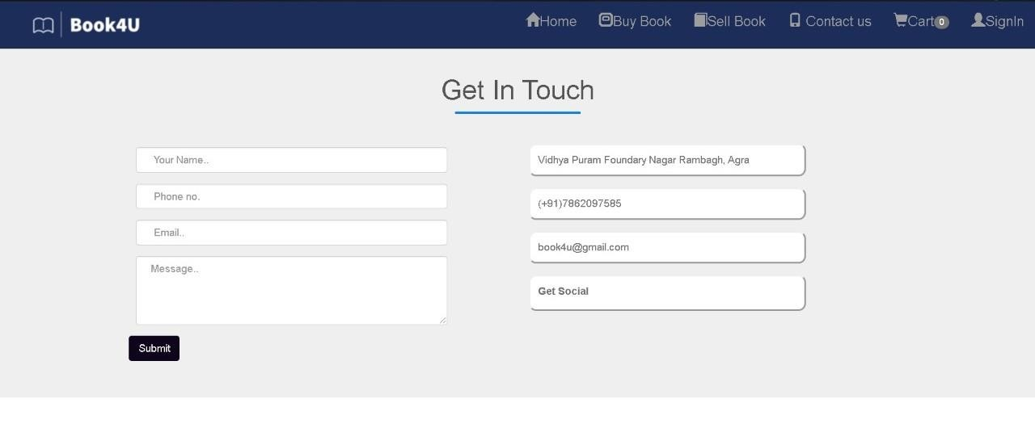
Contact Us page

Slide 19
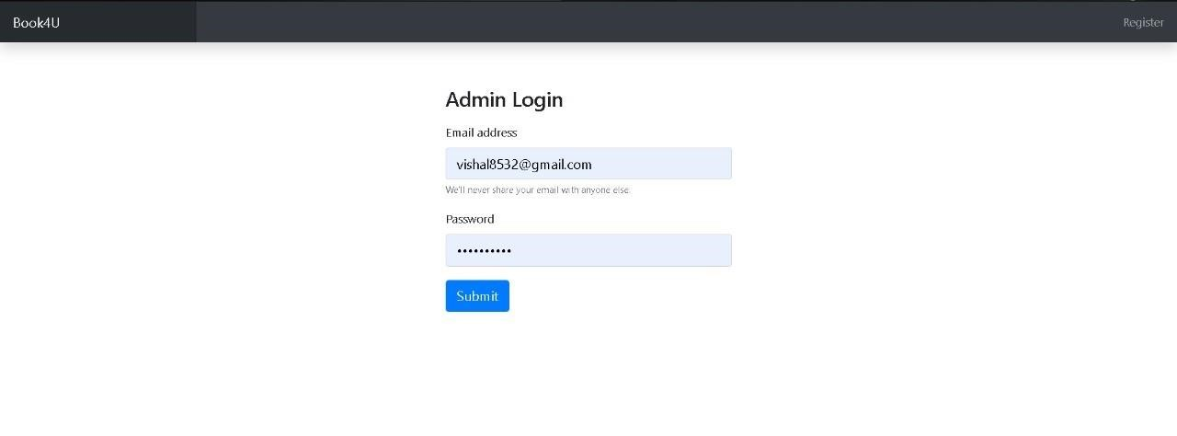
Admin login page

Slide 20
Conclusion
Online Book second hand store is an online web application where the customer can purchase and sell books online.
Through a web browser the customers can search for a book by its title or author, later can add to the shopping cart and finally purchase and sell the books.

Slide 21
References
www.w3schools.com
www.tutorialspoint.com

Slide 22

THANK YOU!

